Slide 1




NASJET
INTRODUCE OUR COMPANY

Slide 2
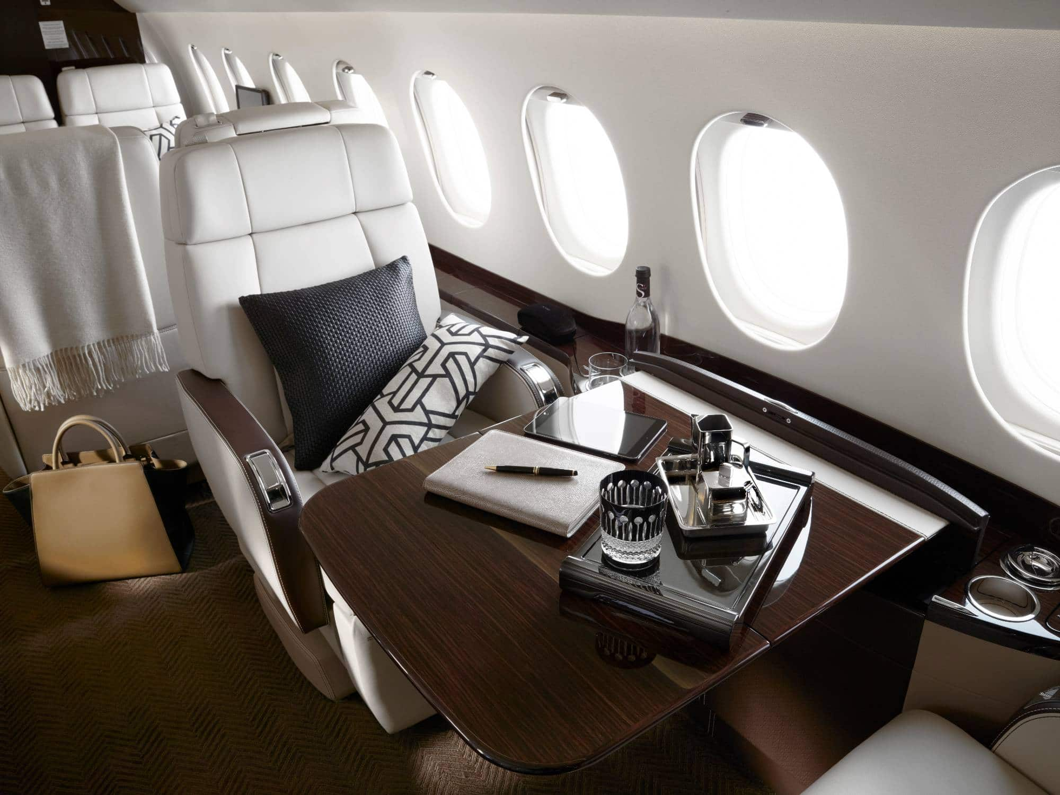

NasJet:
Elevate Your Journey
+7
7
BUSINESS
JETS
MODELS
Оperates 24/7 from a state-of-the-art flight center in Riyadh, Saudi Arabia, delivering superior levels of safety, service and value.
NasJet has grown to managing and supporting in excess of 7 fixed-wing aircraft, and employing 90 in-house aviation industry experts.

Slide 3

The NasJet Heritage
In 2025, NasJet proudly looks back on nearly 26 years of operational excellence, serving clients across the globe. Established in Saudi Arabia with a Royal Decree, NasJet was the first private company in the Kingdom to receive an Aircraft Operating Certificate. Today, with a thriving business exceeding in turnover and managing 7 aircraft, NasJet stands as the leading full-service operator in the Middle East.
The company continues to be recognized for its outstanding operational proficiency.

Slide 4

The NasJet
Vision
NasJet is driven by a clear vision for the future, aiming to be a leader in business aviation solutions in the Middle East. Our mission centers on prioritizing customer satisfaction above all, reflecting our unwavering commitment to delivering exceptional experiences.

Slide 5





Defining NasJet
NasJet stands on four key pillars:
Security:
Your safety is our
utmost priority
Luxury:
Sustainability:
Innovation:
We redefine opulence
and convenience
Pioneering eco-friendly
aviation
Tech-driven, seamless
travel experiences

Slide 6

NasJet sets itself apart
Uncompromising Security:
Opulent
Luxury:
Rigorous safety measures and top certifications
Elevating comfort and convenience to new heights
Eco-Friendly Commitment:
Cutting-Edge Innovation:
Aligning with Vision 2030
for a greener future
Leveraging technology
for seamless journeys

Slide 7
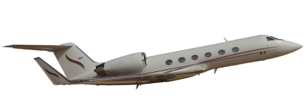
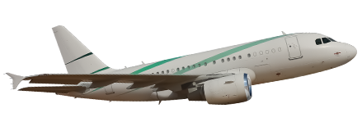
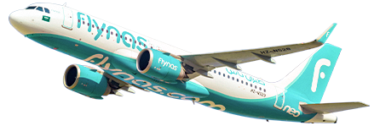
NASJET Core Fleet
Gulfstream
(GIV-SP)
Airbus Corporate Jet (ACJ) A318
Airbus A320neo
The Airbus A320neo boasts innovative tech and the widest single-aisle cabin. New-gen engines cut fuel consumption and emissions by 15%, and noise by 50%.
NASJET is the largest Gulfstream operator in the Middle East.
You can fly in a spacious and comfortable cabin, which includes a full-service galley
to serve your favorite meals
In NASJET we have two types
of Airbus A318 combine Airbus reliability and intercontinental performance.

Slide 8
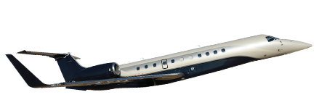
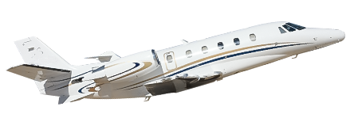
NASJET Core Fleet
Legacy 650
Gulfstream (G450)
Our refurbished Legacy 650 offers the largest baggage capacity for our VIP clients.
Citation Excel
NASJET, the Middle East's largest Gulfstream operator, offers spacious, comfortable cabins with full-service galleys for your favorite meals.
Efficiency and comfort in a beautiful midsize jet. Spacious cabin with wide, reclining leather seats for ultimate comfort.

Slide 9

Our Services
TAILORED LUXURY
Aircraft Management:
We handle maintenance, crew, and compliance, so your aircraft is always ready to fly. Enjoy ownership without the administrative hassle - your asset, our expertise.

Slide 10
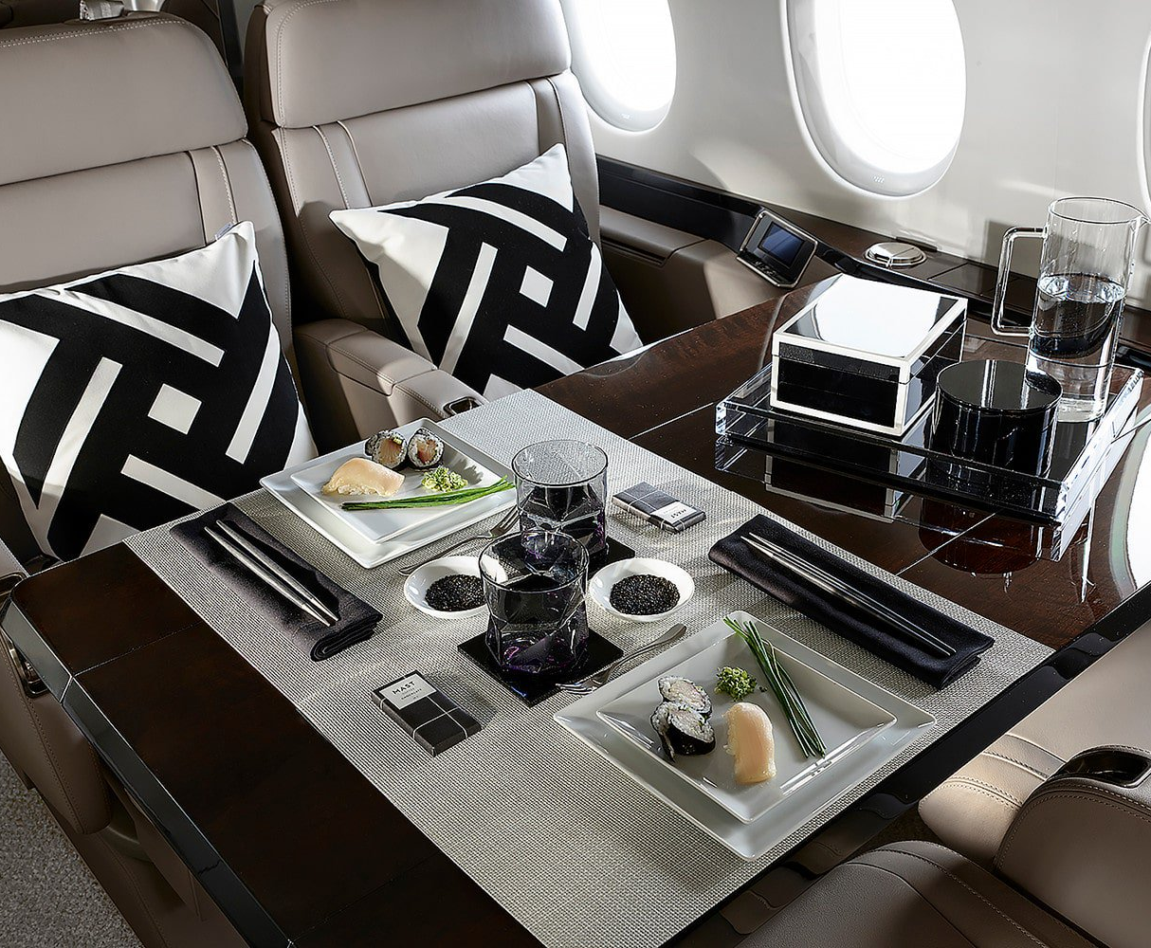
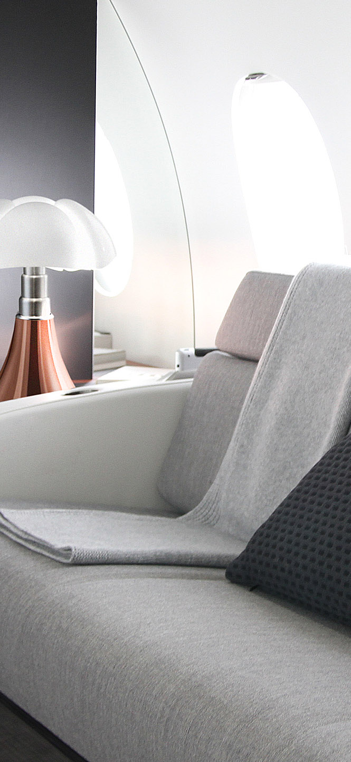
Aircraft Charters:
NasJet's Aircraft Charters offer ultimate luxury
and flexibility. Fly on your terms, choose from our
well-maintained fleet. Whether for business or leisure, experience the convenience and privacy of private jet travel, tailored to you. Elevate your journey with NasJet.
Completions Advisory:
NasJet's Completions Advisory tailors your aircraft to perfection. Our experts guide customization, from interiors to amenities, creating a personalized flying oasis. With NasJet, your vision becomes reality, reflecting your unique style.

Slide 11


Flight Support -Aircraft Owners:
Aircraft Sales:
NasJet's Aircraft Charters offer ultimate luxury and flexibility. Fly on your terms, choose from our
well-maintained fleet. Whether for business or leisure, experience the convenience and privacy of private jet travel, tailored to you. Elevate your journey with NasJet.
We connect buyers with premium options, ensuring a transparent and reliable process. Whether buying or selling, count on our expertise for a seamless transaction.

Slide 12



Collaborations
and Commitment
NasJet is known for its strategic collaborations with industry leaders, enriching its array of services and offerings. These collaborations empower NasJet to deliver top-tier solutions to its valued clients, ensuring excellence throughout the private aviation experience.
Certifications: NasJet holds all certifications required from the relevant aviation authority, including IS-BAO Stage 3 certification, affirming its adherence to international quality standards.

Slide 13


Diverse aircraft portfolio:
NasJet operates a portfolio of aircraft that includes over seven different brands, demonstrating our versatility in the aviation industry.
NasJet, headquartered in Saudi Arabia, plays a pivotal role
in supporting Saudi Vision 2030 by contributing to economic diversification. With a commitment to sustainability, NasJet aligns withVision 2030's green objectives, focusing on eco-friendly initiatives
and environmental responsibility.

Slide 14

What Client Say
Abdulaziz B.
Aircraft Owner
NasJet made owning an aircraft a breeze.
Their Aircraft Management service is
top-notch. From maintenance to crew management, they handle everything seamlessly. I no longer worry about the administrative hassles of aircraft ownership. NasJet truly understands the needs
of aircraft owners, and I couldn't be happier with their service.
We don't just provide flights; we craft extraordinary journeys.

Slide 15

Thank You
And have a Safe flight!
nasjet.com.sa

